Slide 1
Java Object Oriented
Università di Modena e Reggio Emilia
Prof. Nicola Bicocchi (nicola.bicocchi@unimore.it)

Slide 2
Project Modularization

Slide 3
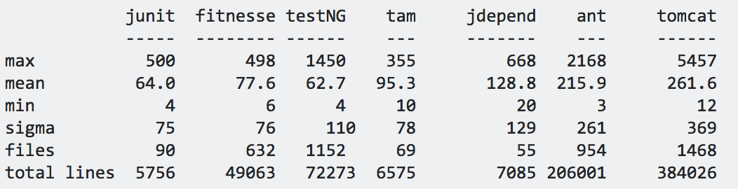
Motivation
Classes are better at modularizing code than functions. However, they are still little (50-250 lines of code, on average)
For the sake of additional modularization, packages are used
A package is a set of class definitions all stored within the same directory
The public interface of a package is the public portion of the classes contained in the package
Best practice: minimize the number of classes, attributes, and methods (of the package) visible from the outside

Slide 4
Package
A package is identified by a name with a hierarchic structure (fully qualified name)
java.lang
java.util
java.sql
Conventions for defining unique names is based on Internet naming but in reverse order (from general to specific concepts)
com.nbicocchi.exercises
It’s possible to use same class names in different packages without conflicts. However, if you need both classes you have to use one of them with its fully-qualified name:
import java.sql.Date; Date d1 = new Date();
java.util.Date d2;
d2 = new java.util.Date();

Slide 5
Java 9 Modularity
https://www.baeldung.com/java-9-modularity

Slide 6
Classes and Objects

Slide 7


Slide 8


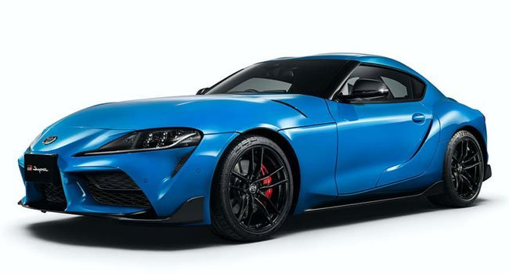

Class
A class is like a type definition:
A class defines a category (i.e., a class) of entities
Memory is not allocated until an object is created from the class
A class is composed of:
Data (Variables, Attributes)
Behaviors (Operations, Methods)

Slide 9
Object
The creation of an object is called instantiation. The created object is called an instance
No limit to the number of objects that can be created from a class
Each object is independent. Changing one object doesn't change the others
Object (class instance)
Type
Identity
Internal state
One or more references must point to every valid object
public static void main(String[] args) {
Object obj = new Object();
# type, identity
System.out.println(obj);
# type, identity
System.out.printf("%s@%x\n",
obj.getClass().getName(),
obj.hashCode());
}

Slide 10
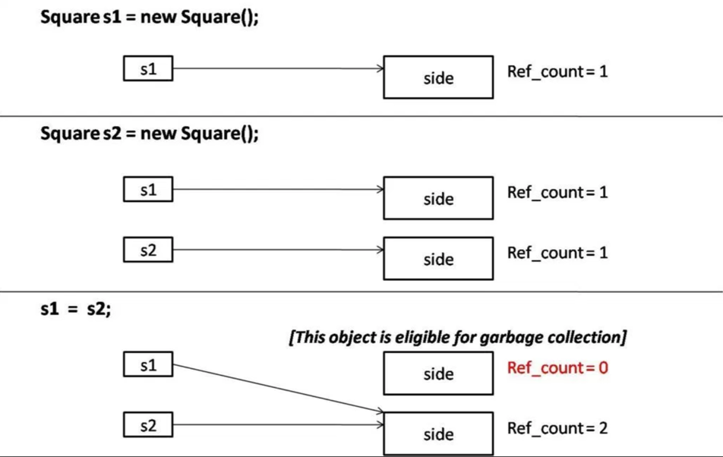
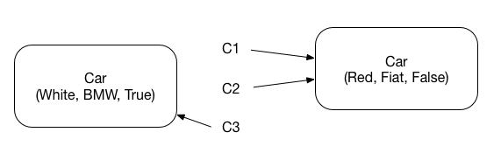
Object creation and destruction
The creation of an object is made with the keyword new which creates a new instance of the specified class
new calls the constructor method of the class and returns a reference to the portion of memory containing the created object (heap)
Car c1 = new Car(Red, Fiat, False);
Car c2 = c1;
Car c3 = new Car(White, BMW, True)
It is no longer a developer concern
Java supports Automatic Garbage Collection (an automatic way for de-allocating unreferenced objects)

Slide 11
Operations on references
Only the relational operators == and != are defined:
The equality condition tells you whether two references point to the same object in memory
The equality condition is evaluated on the values of the references (i.e., addresses in memory)!
References are not pointers. There is NO pointer arithmetic!

Slide 12
Class Design

Slide 13
Class Definition
public class Car {
boolean isOn;
String brand;
String color;
/* Constructor method */
public Car(boolean isOn, String brand, String color) {
this.isOn = isOn;
this.brand = brand;
this.color = color;
}
/* Getters methods */
public String getBrand() {
return brand;
}
public String getColor() {
return color;
}
/* Setter methods */
public void setBrand(String brand) {
this.brand = brand;
}
public void setColor(String color) {
this.color = color;
}
/* User methods */
void turnOff() {
isOn = false;
}
void turnOn() {
isOn = false;
}
}

Slide 14
Encapsulation and Visibility
public class Car {
public String color;
public void setColor(String color) {
this.color = color;
}
}
public class App {
public static void main(String[] args) {
Car c = new Car();
/* Works but unsafe! */
c.color = “red”;
}
}
public class Car {
private String color;
public void setColor(String color) {
this.color = color;
}
}
public class App {
public static void main(String[] args) {
Car c = new Car();
c.color = “red”; /* Compiler error */
c.setColor(“red”); /* Works, Safe! */
}
}

Slide 15
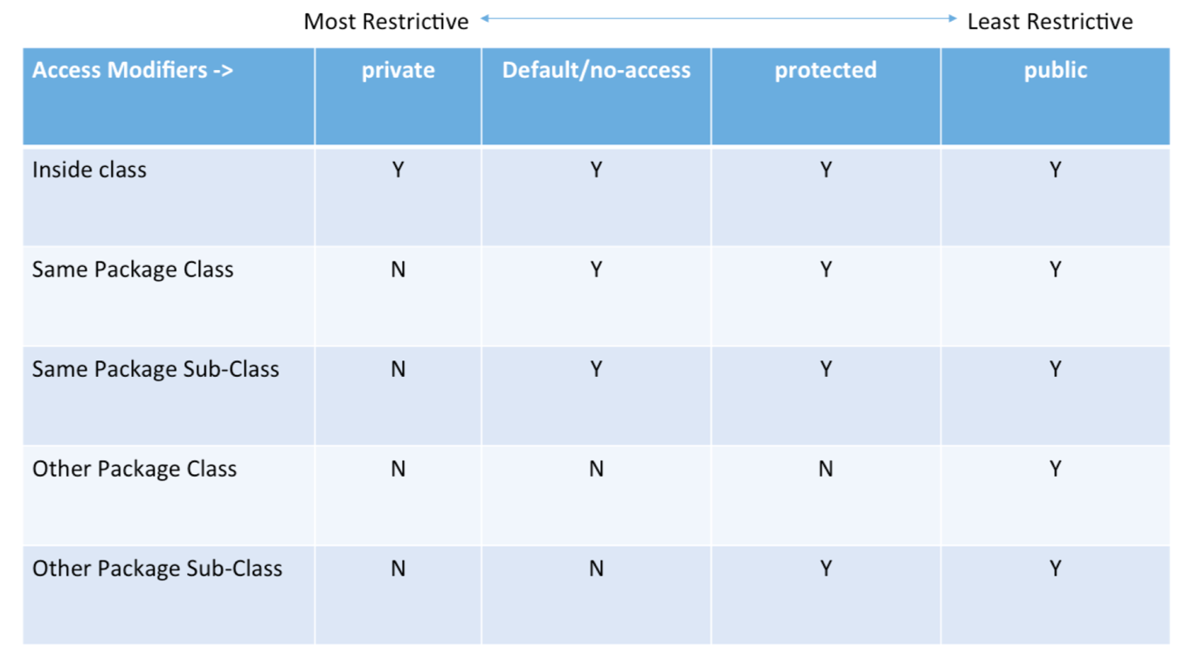
Encapsulation and Visibility

Slide 16
Constructors
Constructors perform attributes initialization
Overloading of constructors is often used
If a class does not define any constructor, a default one (with no parameters, thus performing no initialization) is automatically enabled.
Can be automatically generated in IntelliJ
Code -> Generate…
/* Example with two constructors */
public class Car {
boolean isOn;
String brand;
String color;
public Car() {
this.isOn = false;
this.brand = "Fiat";
this.color = "Punto";
}
public Car(boolean isOn, String brand, String color) {
this.isOn = isOn;
this.brand = brand;
this.color = color;
}
. . .
}

Slide 17
Constructors
public class Car {
private String color;
public void setColor(String color) {
this.color = color;
}
}
public class App {
public static void main(String[] args) {
/* Works with default constructor!
Possibly unsafe: attributes not initialized */
Car c = new Car();
}
}

Slide 18
Constructors
public class Car {
private String color;
/* Constructor */
public Car(String color) {
this.color = color;
}
public void setColor(String color) {
this.color = color;
}
}
public class App {
public static void main(String[] args) {
Car c = new Car(); /* Error! Default Constructor missing! */
Car c = new Car(“Red”); /* Works with defined constructor! */
}
}

Slide 19
Constructors
public class Car {
private String color;
public Car() {
this.color = “Red”;
}
public Car(String color) {
this.color = color;
}
. . .
}
public class App {
public static void main(String[] args) {
Car c = new Car(); /* Works with defined constructor! */
Car c = new Car(“Red”); /* Works with defined constructor! */
}
}

Slide 20
The keyword this
It can be useful in methods to distinguish between instance variables and local variables (this represents a reference to the current object)
this.variable refers to an instance variable encapsulated within the current object
this is not required if there are no ambiguities
/* Example with two constructors */
public class Car {
String brand;
String color;
public Car() {
brand = "Opel";
color = "Astra";
}
public Car(String brand, String color) {
this.brand = brand;
this.color = color;
}
. . .
}

Slide 21
Getters and Setters
Since attributes are usually encapsulated, methods for reading and writing them are needed. These methods are called getters and setters.
For reducing the number of errors, using the same name for method parameters and class attributes is a good practice!
Can be automatically generated in IntelliJ Code -> Generate…
class Car {
String licence;
...
public String getLicence() {
return licence;
}
public void setLicence(String licence) {
this.licence = licence;
}
}

Slide 22
Getters and Setters
Why use getters and setters/accessors? (Answer #1)
Encapsulation of behaviour associated with getting or setting the property - this allows additional functionality (like validation) to be added more easily later.
Hiding the internal representation of the property while exposing a property using an alternative representation.
Insulating your public interface from change - allowing the public interface to remain constant while the implementation changes without affecting existing consumers.
Controlling the lifetime and memory management (disposal) semantics of the property - particularly important in non-managed memory environments (like C++ or Objective-C).
Providing a debugging interception point for when a property changes at runtime - debugging when and where a property changed to a particular value can be quite difficult without this in some languages.
Improved interoperability with libraries that are designed to operate against property getter/setters - Mocking, Serialization, and WPF come to mind.
Allowing inheritors to change the semantics of how the property behaves and is exposed by overriding the getter/setter methods.
Allowing the getter/setter to be passed around as lambda expressions rather than values.
Getters and setters can allow different access levels - for example the get may be public, but the set could be protected.
https://stackoverflow.com/questions/1568091/why-use-getters-and-setters-accessors

Slide 23
Getters and Setters
Why use getters and setters/accessors? (Answer #2)
Because 2 weeks (months, years) from now when you realize that your setter needs to do more than just set the value, you'll also realize that the property has been used directly in 238 other classes :-)
https://stackoverflow.com/questions/1568091/why-use-getters-and-setters-accessors

Slide 24
Getters and Setters
class Car {
String licence;
...
public String getLicence() {
return licence;
}
public void setLicence(String licence) {
if (licence.length() != 7) {
throw new IllegalArgumentException("Length != 7");
}
this.licence = licence;
}
}

Slide 25
toString()
It is handy to obtain a textual representation of objects
In order to provide objects with this feature the toString() method have to be overridden (the default implementation resides in the Object class)
Can be automatically generated in IntelliJ Code -> Generate…
public class Point { int x, y; public Point(int x, int y) { this.x = x; this.y = y; } @Override public String toString() { return "Point{" + "x=" + x + ", y=" + y + '}'; } public static void main(String[] args) { System.out.println(new Point(2, 3)); } }
# Output
Point{x=2, y=3}

Slide 26
Static attributes, methods, classes

Slide 27
Static attributes and methods
Static attributes and methods belong to a class, not to a particular instance!
They are common to all instances of an object and exist even when no object has been instantiated!
Static methods only have access to the static portion of their class (instances might not exists!)
Widely used for defining standalone functions inside OO software. Classes, in this case, are used just as containers.
See Math, Arrays, Collections classes.
Class Car {
public static final int WHEELS = 4;
public static boolean validLicence(String licence) {
if (licence.length() != 7) {
return false;
}
. . .
return true;
}
}
public static void main(String[] args) {
/* access to static attributes */
int wheels = Car.WHEELS;
if (Car.validLicence(“AA958RV”)) {
. . .
}
}

Slide 28
Static classes
Java allows a class to be defined within another class. These are called nested classes.
Unlike top-level classes, Inner classes can be static.
A static nested class may be instantiated without instantiating its outer class.
@See com.nbicocchi.exercises.collections.mycollections.MyLinkedList

Slide 29
Java.lang.Object

Slide 30
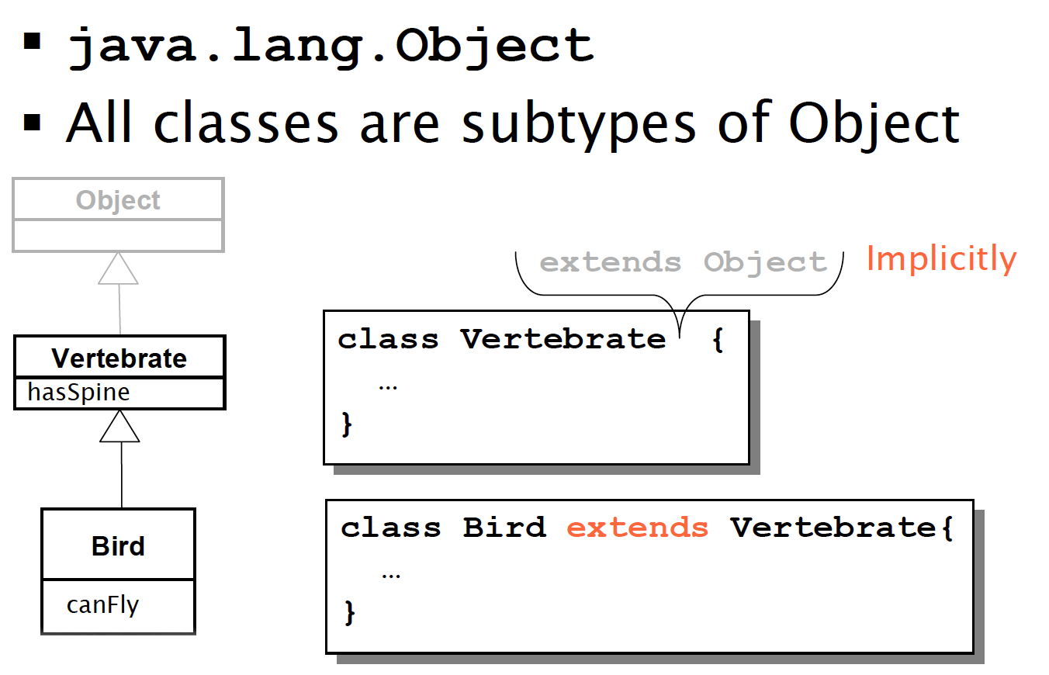
Java.lang.Object

Slide 31
Java.lang.Object
All objects can be seen as Object instances
Object defines basic services, which are useful for all classes. They are often overridden in sub-classes. For example:
toString(): returns a string representation
equals(Object o): tests content equality
hashCode(): returns the hash code of the object
clone(): returns a shallow copy of the object

Slide 32
.toString()
Every class descends from the Object class. Since the Object class defines the toString() method, we can call toString() on any object and get its string representation.
Whenever we print an object reference, println() invokes the toString() method internally.
If we don't define a toString() method in our class, then Object.toString() is invoked.
public class Car {
String brand;
String color;
public Car(String brand, String color) {
this.brand = brand;
this.color = color;
}
. . .
}
#Output (Object implementation of toString())
com.nbicocchi.exercises.Car@31f1e5

Slide 33
.equals()
We can use == operators for reference comparison (address comparison) and .equals() method for content comparison.
In simple words, == checks if both objects point to the same memory location whereas .equals() evaluates to the comparison of values in the objects.
If a class does not override the equals method, then, by default, it uses the equals(Object o) implementation of the closest parent.
public class Car {
String brand;
String color;
public Car(String brand, String color) {
this.brand = brand;
this.color = color;
}
public static void main(String[] args) {
String s1 = new String("BMW");
String s2 = new String("BMW");
Car c1 = new Car("BMW", "M6");
Car c2 = new Car("BMW", "M6");
System.out.println(s1 == s2); // false
System.out.println(s1.equals(s2)); // true
System.out.println(c1 == c2); // false
System.out.println(c1.equals(c2)); // false
}
}

Slide 34
.equals()
If two objects are equal according to the equals(Object) method, then calling the hashCode method on each of the two objects must produce the same integer result.
You must override hashCode() in every class that overrides equals().
Failure to do so will result in a violation of the general contract for Object.hashCode(), which will prevent your class from functioning properly in conjunction with all hash-based collections, including HashMap, HashSet, and Hashtable. (Joshua Bloch)
public class Car {
String brand;
String color;
public Car(String brand, String color) {
this.brand = brand;
this.color = color;
}
@Override
public boolean equals(Object o) {
if (this == o)
return true;
if (o == null || getClass() != o.getClass())
return false;
Car car = (Car) o;
return Objects.equals(brand, car.brand) && Objects.equals(color, car.color);
}
@Override
public int hashCode() {
return Objects.hash(brand, color);
}
}

Slide 35
clone()
Constructors are a good way for generating objects which are copies of other objects
If proper constructors are not available, the method .clone() can be used instead
clone() returns an Object reference, thus casting is necessary to use the cloned object
Point p1 = new Point(2,3);
Point p2 = new Point(p1); p2.setLocation(4,4); System.out.println(p1); //2,3 System.out.println(p2); //4,4
Point p1 = new Point(2,3); Point p2 = (Point) p1.clone(); p2.setLocation(4,4); System.out.println(p1); //2,3 System.out.println(p2); //4,4

Slide 36
clone()
When JVM is called for cloning, it does the following things:
If the class has only primitive data type members then a completely new copy of the object will be created and the reference to the new object copy will be returned.
If the class contains members of any class type then only the object references to those members are copied and hence the member references in both the original object as well as the cloned object refer to the same object (this is called shallow copy)
https://howtodoinjava.com/java/cloning/a-guide-to-object-cloning-in-java/
ArrayList<Point> l1 = new ArrayList<>(); l1.add(new Point(1, 1)); l1.add(new Point(2, 2)); l1.add(new Point(3, 3)); ArrayList<Point> l2 = (ArrayList) l1.clone(); l2.get(0).setLocation(9,9);
System.out.println(l1); System.out.println(l2);
[java.awt.Point[x=9,y=9], java.awt.Point[x=2,y=2], java.awt.Point[x=3,y=3]]
[java.awt.Point[x=9,y=9], java.awt.Point[x=2,y=2], java.awt.Point[x=3,y=3]]

Slide 37
Wrapper Classes

Slide 38
Wrapper Classes
In an ideal OO environment, only classes and objects should exist
For the sake of performance, Java also uses primitive types (int, float, etc.). Other languages, such as Python, do not support primitive types (everything is an object).
Wrapper classes are objectivized versions of primitive types. They provide several methods for converting to and from primitive types, objectivized versions and Strings, as well as other constants and useful methods.
boolean Boolean
char Character
byte Byte
short Short
int Integer
long Long
float Float
double Double
void Void

Slide 39
Wrapper Classes
In an ideal OO environment, only classes and objects should exist
For the sake of performance, Java also uses primitive types (int, float, etc.). Other languages, such as Python, do not support primitive types (everything is an object).
Wrapper classes are objectivized versions of primitive types
Wrapper classes provide several methods for converting to and from primitive types, objectivized versions and Strings, as well as other constants and useful methods.
class myInteger { int n; public myInteger(int n) { this.n = n; } public int getN() { return n; } public void setN(int n) { this.n = n; } }
// Pay Attention: 10X – 100X slower!

Slide 40
Conversions
autoboxing
obj.toString();
Integer
autounboxing
Integer.valueOf(String);
Integer.toString(int);
String.format()
int
String
Integer.parseInt(String);
Integer.parseInt(String, base);

Slide 41
Auto boxing/unboxing
Auto boxing is the automatic conversion from primitive types and their corresponding wrapper classes. The plain variable is boxed into an object.
int -> Integer
Auto unboxing, on the contrary, is the automatic conversion from wrapper classes to their corresponding primitive types.
Integer -> int
public class AutoboxingExample {
public static Integer double(Integer n) { return n * 2; }
public static void main(String[] args) { int i = 2 + double(2); } }

Slide 42
Inheritance

Slide 43
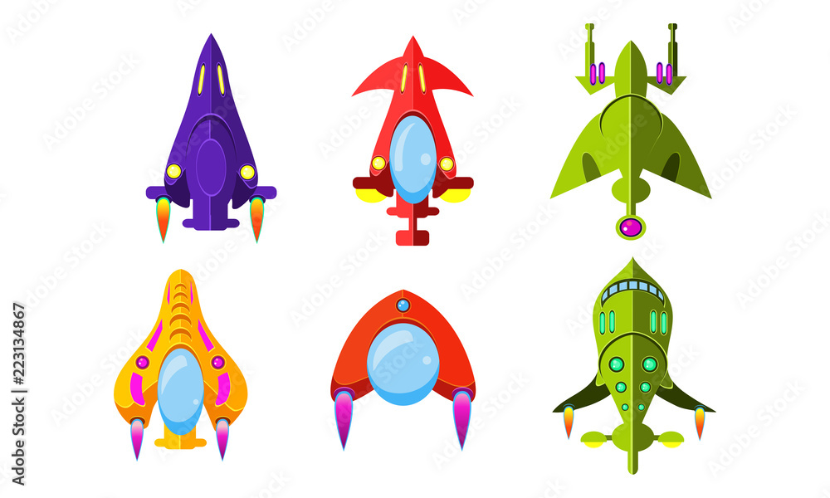
Motivation
All space ships have a shape, weapons, and defenses... Can they share the same code?
Benefits of localization of code
Fixing a bug in the base class automatically fixes it in the subclasses
Adding functionalities to the base class automatically adds them to the subclasses
Reduced chances of different (and inconsistent) implementations of the same operation

Slide 44
Inheritance
A class can be a sub-type of another class (only one!)
The inheriting class contains implicitly all the attributes and methods of the class it inherited from
The inheriting class can:
define additional attributes and methods
override the definition of existing methods
Class Car {
boolean isOn;
String licensePlate;
void turnOn() {…}
void turnOff() {…}
}
Class SDCar extends Car {
}
SDCar c = new SDCar();
c.turnOn(); // OK!
*SD = Self Driving

Slide 45
Example I (extension)
Class Car {
boolean isOn;
String licensePlate;
void turnOn() {…}
void turnOff() {…}
}
Class SDCar extends Car {
boolean isSelfDriving;
void turnSDOn() {…}
void turnSDOff() {…}
}
SDCar c = new SDCar();
c.turnOn(); // OK!
c.turnSDOn(); // OK!
*SD = Self Driving

Slide 46
Example II (override)
Class Car {
boolean isOn;
String licensePlate;
void turnOn() {…}
void turnOff() {…}
}
Class SDCar extends Car {
boolean isSelfDriving;
/* method override */
void turnOn() {
turnSDOff();
/* … */
}
/* method override */
void turnOff() {
turnSDOff();
/* … */
}
void turnSDOn() {…}
void turnSDOff() {…}
}

Slide 47
Example III (override using super)
Class Car {
boolean isOn;
String licensePlate;
void turnOn() {…}
void turnOff() {…}
}
Class SDCar extends Car {
boolean isSelfDriving;
/* override */
void turnOn() {
turnSDOff();
super.turnOn();
}
void turnOff() {
turnSDOff();
super.turnOff();
}
void turnSDOn() {…}
void turnSDOff() {…}
}

Slide 48
this and super
this is a reference to the current object
super is a reference to the parent class

Slide 49
Terminology
Class one above
Parent class
Class one below
Child class
Class one or more above
Superclass, Ancestor class, Base class
Class one or more below
Subclass, Descendent class

Slide 50
Inheritance and Visibility

Slide 51
Inheritance and Visibility
Class Car {
private boolean isOn;
private string licensePlate;
public void turnOn() {…}
public void turnOff() {…}
}
Class SDCar extends Car {
void print() {
/* Do not work! Not visible! */
System.out.println(licencePlate);
}
}

Slide 52
Inheritance and Visibility
Class Car {
boolean isOn;
string licensePlate;
public void turnOn() {…}
public void turnOff() {…}
}
Class SDCar extends Car {
void print() {
/*
* Works if Car and SDCar
* are located within the same package
*/
System.out.println(licencePlate);
}
}

Slide 53
Inheritance and Visibility
Class Car {
protected boolean isOn;
protected string licensePlate;
public void turnOn() {…}
public void turnOff() {…}
}
Class SDCar extends Car {
void print() {
/* Works anyway! */
System.out.println(licencePlate);
}
}

Slide 54
Inheritance and Constructors

Slide 55
Construction of child objects
Since each subclass “contains” an instance of the parent class, the latter must be initialized
Java compiler automatically calls the default constructor (no params!) of the parent class
The call is inserted as the first statement of each child constructor. If parent class disabled default constructor (by defining others) parent constructor must be called explicitly!

Slide 56
Construction of child objects
class Car {
boolean isOn;
String licensePlate;
/* Default constructor disabled! */
public Car(boolean isOn, String licensePlate) {
this.isOn = isOn;
this.licencePlate = licensePlate;
}
}
class SDCar extends Car {
boolean isSelfDriving;
/* Default constructor disabled! */
public SDCar(boolean isOn, String licensePlate, boolean isSelfDriving) {
super(isOn, licencePlate);
this.isSelfDriving = isSelfDriving;
}
} // Works!

Slide 57
Construction of child objects
class Car {
boolean isOn;
String licensePlate;
/* Default constructor enabled! */
}
class SDCar extends Car {
boolean isSelfDriving;
/* Default constructor enabled! */
} // Works!

Slide 58
Construction of child objects
class Car {
boolean isOn;
String licensePlate;
/* Default constructor enabled! */
}
class SDCar extends Car {
boolean isSelfDriving;
/* Default constructor disabled! */
public SDCar() {
/* automatic call to parent default constructor here! */
}
} // Works!

Slide 59
Construction of child objects
class Car {
boolean isOn;
String licensePlate;
/* Default constructor disabled! */
public Car(boolean isOn, String licensePlate) {
this.isOn = isOn;
this.licencePlate = licensePlate;
}
}
class SDCar extends Car {
boolean isSelfDriving;
/* Default constructor disabled! */
public SDCar() {
/* automatic call to parent default constructor here! */
}
} // Not working!

Slide 60
Construction of child objects
Execution of constructors proceeds top-down along the inheritance hierarchy
In this way, when a method of the child class is executed (constructor included), the super-class is completely initialized already
class Car{
Car() {
super();
System.out.println(“Car”);
}
}
class SDCar extends Car {
SDCar() {
super();
System.out.println(“SDCar”);
}
}
SDCar c = new SDCar();
# Output:
// Car
// SDCar

Slide 61
Overriding and Polymorphism
When using collections of objects belonging to a hierarchy of classes, the actual methods which are called are known only at runtime.
The same method call (methods with the same signature) might have different results (polymorphism) depending on the actual class of the object.
* https://en.wikipedia.org/wiki/Late_binding
Car[] garage = new Car[4];
garage[0] = new Car();
garage[1] = new SDCar();
garage[2] = new SDCar();
garage[3] = new Car();
for(Car c : garage) {
c.turnOn();
}
/*
Which method is actually called
is not knowable at compile time!
*/

Slide 62
Overloading and Polymorphism
Methods may have parameters
Inside a class, methods with the same name but different signatures are allowed
A signature is made by:
Method name
Ordered list of parameters types
The method whose parameters types matches, is selected to be executed
public class Foo {
public int doit(int n, String s) {
return n + s.length();
}
public int doit(String s, int n) {
return n * s.length();
}
public static void main(String[] args) {
Foo f = new Foo();
System.out.println(f.doit(5, "Foo")); // 8
System.out.println(f.doit("Foo", 5)); // 15
}
}

Slide 63
Casting

Slide 64
Types
Java is a statically typed language
Both references and objects have a type
float f;
f = 4.7; //OK
f = “hello!”; //Compile-time error
Car c;
c = new Car(); //OK!
c = new String(); //Compile-time error

Slide 65
Upcasting and Downcasting
Specialization defines a sub-typing relationship (is a ).
All SDCar(s) are Car(s). Not all Car(s) are SDCar(s).
Upcasting and downcasting refer to the possibility of changing the reference type of a given object.
Upcasting consists in using references associated with a more generic type (less methods), while down-casting with more specific type (more methods).
class Car {};
class SDCar extends Car {};
Car c1 = new Car(); // OK!
SDcar c2 = new SDCar (); // OK!
But also…
Car c3 = new SDcar();
Il pro dell’upcasting è che generalizzo.
Lo svantaggio è che perdiamo l’accesso ad alcuni attributi
Upcast
Downcast
SDCar(s)
Car(s)

Slide 66
Upcasting and Downcasting
Reference Car
Car c1 = sdc
Reference SDCar
SDCar c2 = sdc
Actual Object
SDCar sdc = new SDCar()
Method call
c.turnOn()
Method call
c.turnSDOn()

Slide 67
Upcasting
Upcasting refers to the use of a reference which is more general (closer to Object type) than the actual type of the object itself
Note well: references and objects are separate concepts. Object referenced by ‘c’ continues to be of SDCar type! Only the reference (i.e., the external interface) changes!
It is dependable: It is always true that an SDCar is a Car too
It is automatic: Car c = new SDCar();

Slide 68
Example
class Car {
boolean isOn;
string licensePlate;
void turnOn() {…}
void turnOff() {…}
}
class SDCar extends Car {
boolean isSelfDriving;
void turnSDOn() {…}
void turnSDOff() {…}
}
SDCar c1 = new SDCar();
c1.turnSDOn() // OK!
// Upcast
Car c2 = c1;
// Compile time error!
// Car reference does not allow
// turnSDOn() method call
c2.turnSDOn()

Slide 69
Upcast to object
Every class is either directly or indirectly a subclass of Object
It is always possible to upcast any reference to Object
The price to pay is losing access to all methods more specific than those defined in Object
AnyClass any = new AnyClass();
Object obj = (Object)any;
Object obj = (Object) new Car();
obj.turnOn() // compile-time error

Slide 70
Downcasting
Downcasting refers to the use of a reference which is more specific (closer to the type of the object itself) than current reference
MUST be explicit because it’s a risky operation, no automatic conversion provided by the compiler (it’s up to you!)

Slide 71
Example
class Car {
boolean isOn;
string licensePlate;
void turnOn() {…}
void turnOff() {…}
}
class SDCar extends Car {
boolean isSelfDriving;
void turnSDOn() {…}
void turnSDOff() {…}
}
Car c1 = new SDCar();
// Compile time error!
c1.turnSDOn()
// Downcast
SDCar c2 = (SDcar)c1;
// Accidentally OK!
// The object referenced by c1 was actually of class SDCar
c2.turnSDOn()

Slide 72
Example
Class Car {
boolean isOn;
string licensePlate;
void turnOn() {…}
void turnOff() {…}
}
Class SDCar extends Car {
boolean isSelfDriving;
void turnSDOn() {…}
void turnSDOff() {…}
}
Car c1 = new Car();
// Compile time error!
c1.turnSDOn()
// Downcast
SDCar c2 = (SDcar)c1;
// Run time error!
c2.turnSDOn()

Slide 73
The instanceof operator
The instanceof operator is useful in avoiding downcast-related runtime errors. The actual type of the object is verified before downcasting its reference.
Car c = new SDCar();
if (c instanceof SDCar){
SDCar sdc = (SDCar) c;
sdc.turnSDOn();
}
// since Java 14
if (c instanceof SDCar sdc){
sdc.turnSDOn();
}

Slide 74
Abstract Classes

Slide 75
Abstract methods
Tou can declare a method without implementing it (i.e., the body of the method is missing):
public abstract void draw(int size);
A method that has been declared but not implemented is called an abstract method
75

Slide 76
Abstract classes
Any class containing one or more abstract methods is an abstract class
An abstract class is incomplete in the sense it has missing method bodies
You must declare the class with the keyword abstract:
abstract class MyClass {...}
You cannot instantiate (create a new instance of) an abstract class
You can extend (subclass) an abstract class
If the subclass defines all the inherited abstract methods, it is concrete and can be instantiated
If the subclass does not define all the inherited abstract methods, it must be abstract too
You can declare a class to be abstract even if it does not contain any abstract methods
This just prevents the class from being instantiated

Slide 77
Why use abstract classes?
Suppose you wanted to create a class Shape, with subclasses Oval, Rectangle, Triangle, Hexagon, etc.
Each subclass implements a method draw() for representing its shape on a 2D graphic panel
class Shape { ... }
class Star extends Shape { void draw() { ... } ... }
class Circle extends Shape { void draw() { ... } ... }

Slide 78
A problem
class Shape { ... }
class Star extends Shape { void draw() { ... } ... }
class Circle extends Shape { void draw() { ... } ... }
// Legal, but unwanted
Shape s = new Shape();
// Illegal, Shape does not have draw()
s.draw();
// Legal, because a Star is a Shape
s = new Star();
// Illegal, Shape does not have draw()
s.draw();
// same problem, another view
Shape[] shapes = new Shape[16];
shapes[0] = new Circle();
shapes[1] = new Star();
…
for (Shape s : shapes) {
// Illegal, Shape does not have draw()
s.draw();
}

Slide 79
A solution
abstract class Shape { abstract void draw(); }
class Star extends Shape { void draw() { ... } ... }
class Circle extends Shape { void draw() { ... } ... }
Shape s;
s = new Shape(); // Illegal, Shape is abstract
s = new Star(); // Legal, because a Star is a Shape
s.draw(); // Legal, Shape does have draw()

Slide 80
Interfaces

Slide 81
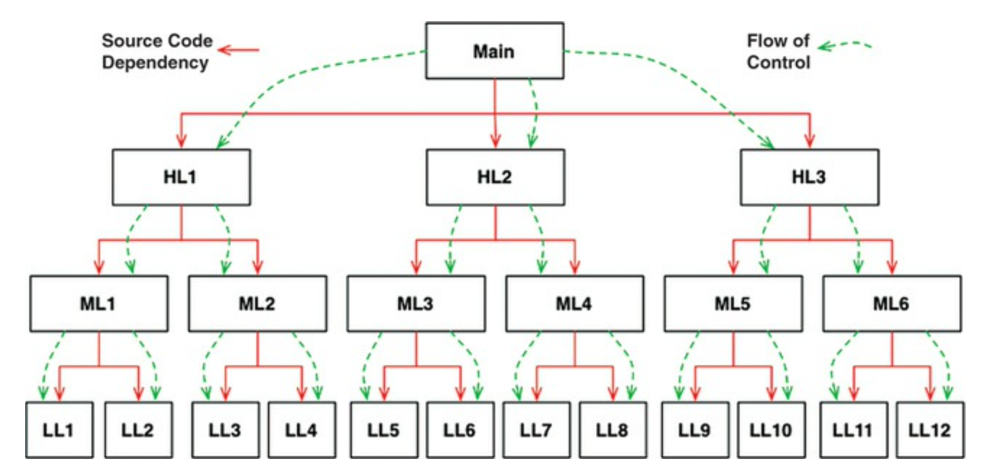
Interfaces
Completely abstract concepts can be defined by making use of Interfaces
Interfaces are particular classes containing exclusively abstract methods. All their methods are implicitly public and abstract. Thus, Interfaces cannot be instantiated.
When a class implements an interface, it promises to the compiler to provide an implementation for all the methods declared within the interface
public interface Shape {
double getWidth();
double getHeight();
String draw();
}
81

Slide 82
Interfaces
// an implementation of the abstract concept
class Circle implements Shape {
double width;
double height;
public Circle(double width, double height) {
this.width = width;
this.height = height;
}
@Override
public double getWidth() {
return width;
}
@Override
public double getHeight() {
return height;
}
@Override
public String draw() {
return "I'm a Circle";
}
}
// a user of the abstract concept
. . .
void drawShapes(ArrayList<Shape> shapes) {
for (Shape s : shapes) {
System.out.println(s.draw());
}
}
. . .
// fully abstract concept (guarantees decoupling)
public interface Shape {
double getWidth();
double getHeight();
String draw();
}

Slide 83
Interfaces
class Circle implements Shape {
double width;
double height;
public Circle(double width, double height) {
this.width = width;
this.height = height;
}
@Override
public double getWidth() {
return width;
}
@Override
public double getHeight() {
return height;
}
@Override
public String draw() {
return "I'm a Circle";
}
}
class Rectangle implements Shape {
double width;
double height;
public Rectangle(double width, double height) {
this.width = width;
this.height = height;
}
@Override
public double getWidth() {
return width;
}
@Override
public double getHeight() {
return height;
}
@Override
public String draw() {
return "I'm a Rectangle ";
}
}

Slide 84
Interfaces
abstract class AbstractShape implements Shape {
double width;
double height;
public AbstractShape(double width, double height) {
this.width = width;
this.height = height;
}
@Override
public double getWidth() {
return width;
}
@Override
public double getHeight() {
return height;
}
}
class Circle extends AbstractShape {
public Circle(double width, double height) {
super(width, height);
}
@Override
public String draw() {
return "I'm a Circle";
}
}
class Rectangle extends AbstractShape {
public Rectangle(double width, double height) {
super(width, height);
}
@Override
public String draw() {
return "I'm a Rectangle";
}
}

Slide 85
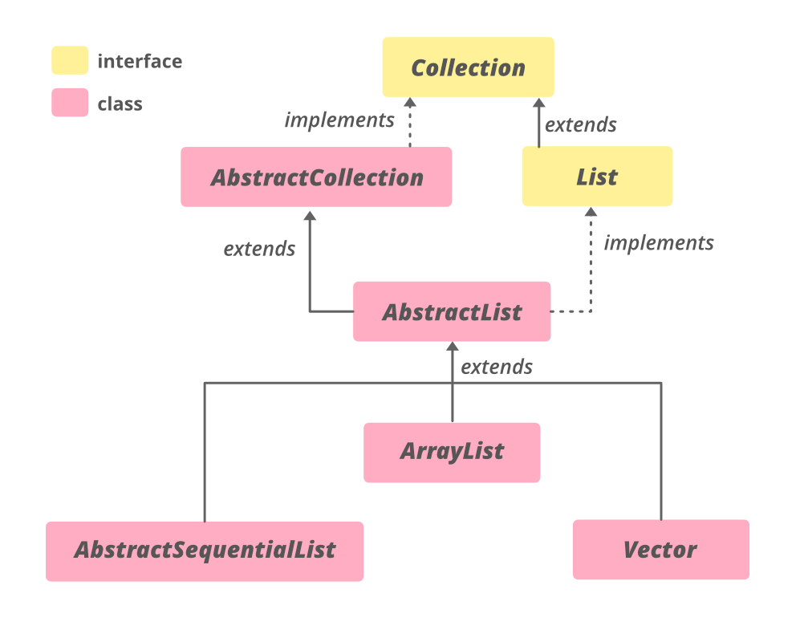
Interfaces
Interfaces can be partially implemented in abstract classes. The approach provides both abstract concepts and reduced code repetition.
Widely used inside the Java API
interface Shape {
public abstract double getWidth(); public abstract void draw();
}
abstract class AbstractShape implements Shape {
double getWidth() { . . . }; abstract void draw(); }
class Star extends AbstractShape { void draw() { ... } ... }
class Circle extends AbstractShape { void draw() { ... } ... }
Abstract
concepts
Implemented
concepts
85

Slide 86
Default/Static methods
In a typical design based on abstractions, where an interface has one or multiple implementations, if one or more methods are added to an interface, all the implementations will be forced to implement them too.
Default methods enable you to add new functionality to the interfaces of your libraries and ensure binary compatibility with code written for older versions of those interfaces.
A static method is a method that is associated with the class in which it is defined rather than with any object. Every instance of the class shares its static methods.

Slide 87
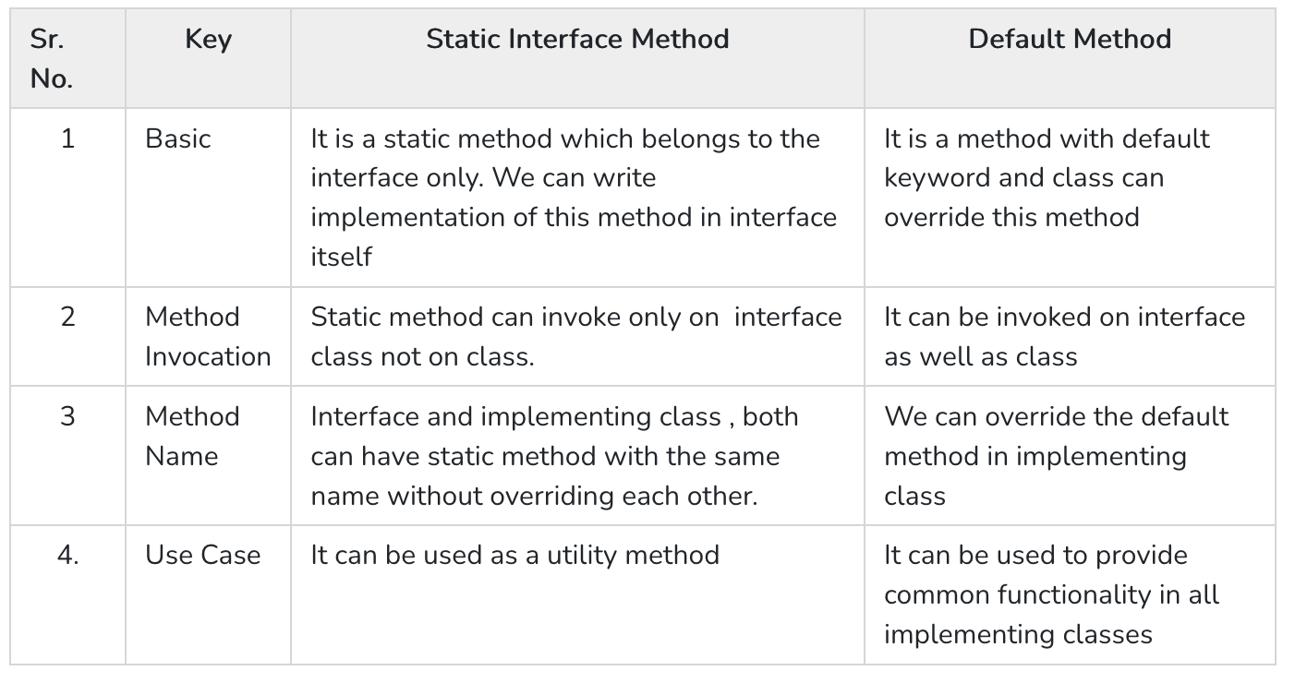
Default/Static methods
public interface DefaultStaticExampleInterface {
default void show() {
System.out.println("DefaultStaticExampleInterface");
}
static void display() {
System.out.println("DefaultStaticExampleInterface");
}
}
public class DefaultStaticExampleClass implements DefaultStaticExampleInterface {
}
public class Main {
static void main(String args[]) {
// Call interface static method on Interface
DefaultStaticExampleInterface.display();
DefaultStaticExampleClass defaultStaticExampleClass = new DefaultStaticExampleClass();
// Call default method on Class
defaultStaticExampleClass.show();
}
}

Slide 88
Multiple inheritance
In Java, a class can only extend one class, but can implement multiple interfaces. This lets the class fill multiple roles (i.e., multiple set of methods)
Collections (e.g., LinkedList) commonly implement multiple interfaces
Graphical containers (e.g., JFrame) commonly implement several listeners (i.e., interfaces)
class LinkedList extends AbstractList implements List, Queue {} class Application extends JFrame implements ActionListener, KeyListener {}

Slide 89
Multiple inheritance
public class GroudVehicle {
activateWheels() {…}
…
}
public class WaterVehicle {
activateWaterFans() {…}
…
}
// Not allowed in Java!! Only one class can be extended!
public class Anphibian extends GroudVehicle, WaterVehicle {
…
}
89

Slide 90
Multiple inheritance
public interface GroudVehicle {
activateWheels();
…
}
public interface WaterVehicle {
activateWaterFans();
…
}
public class Anphibian implements GroudVehicle, WaterVehicle {
activateWheels() {…}
activateWaterFans() {…}
…
}
90

Slide 91
Interfaces and instanceof
class Dog extends Mammal implements Pet, Friend, Fun {...}
Dog lessie = new Dog();
lessie instanceof Object // true
lessie instanceof Dog // true
lessie instanceof Mammal // true
lessie instanceof Pet // true
lessie instanceof Friend // true

Slide 92
Modelling Object Oriented Software

Slide 93
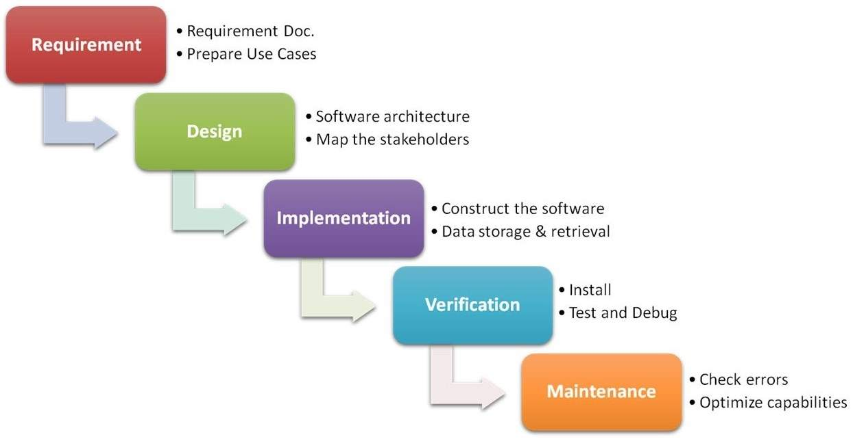
Waterfall model

Slide 94
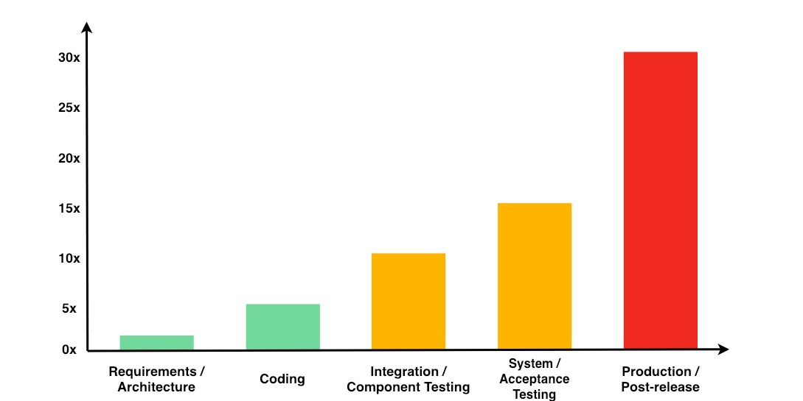
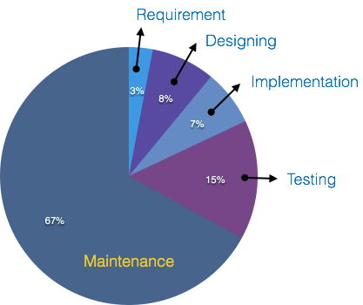
Software life-cycle costs

Slide 95
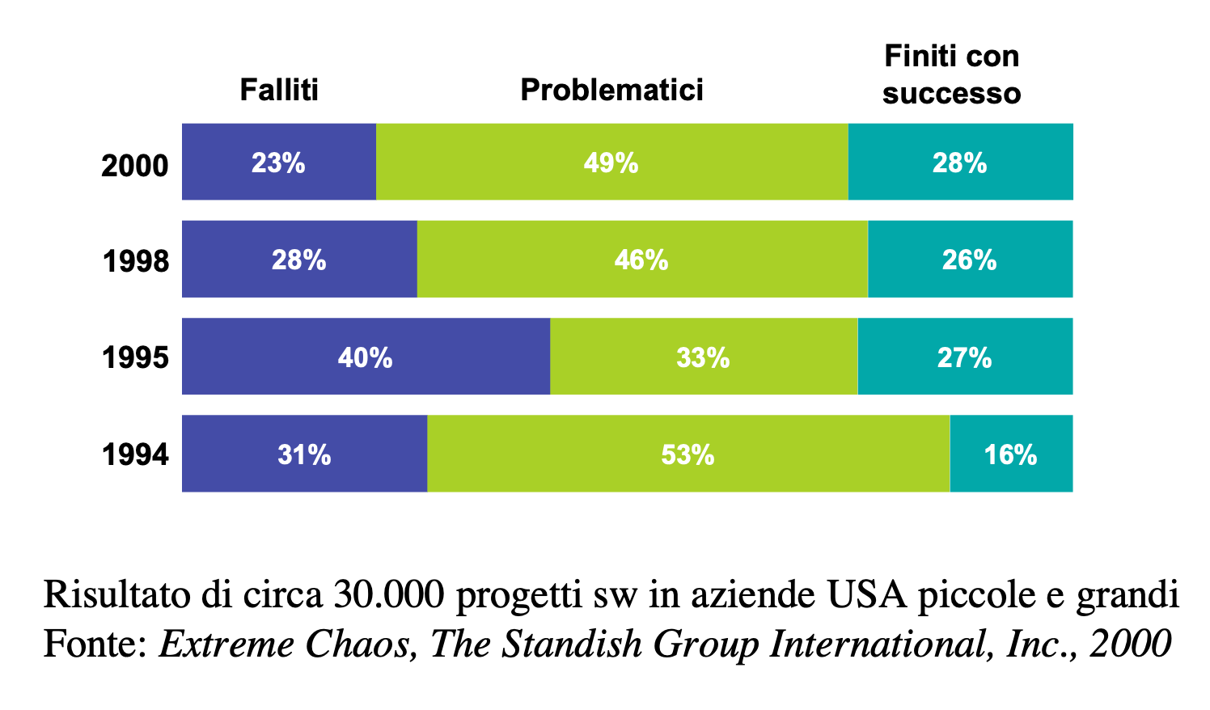
Failure rates of software projects

Slide 96
Root causes of failures
Lack of user participation
Changing requirements
Badly defined system requirements
Unrealistic or unarticulated project goals
Lack of Stakeholder involvement
Unmanaged risks
Poor communication among customers, developers, and users
Use of immature technology
Inability to handle the project’s complexity
Sloppy development practices
Poor project management
Poor reporting of the project’s status
Inaccurate estimates of needed resources
Commercial pressures

Slide 97
So what?
Iterative development models
RUP, SCRUM, Extreme Programming
Modelling tools and languages
SRS, UML
Design Patterns
Factory, Strategy, Proxy, Singleton, State, Iterator, …
https://refactoring.guru/design-patterns

Slide 98
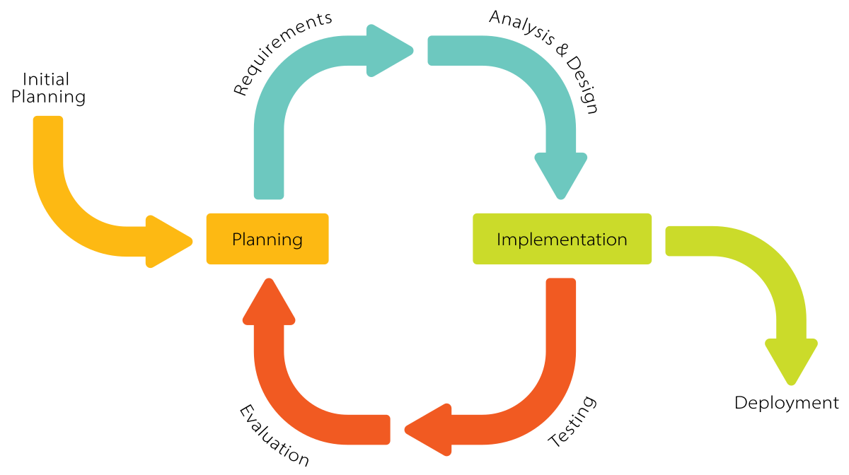
Iterative development models

Slide 99
UML
UML
Unified: has become a world standard
Modeling: describes software systems at a high level of abstraction
Language: expresses ideas
It is a semi-formal language for specifying, visualizing, constructing, and documenting software systems
Simplifies the complex process of software design
Use graphical notation: clearer than both natural language (too loose) and code (too detailed).
Help acquire an overall view of a system.
UML is not dependent on any language or technology.

Slide 100
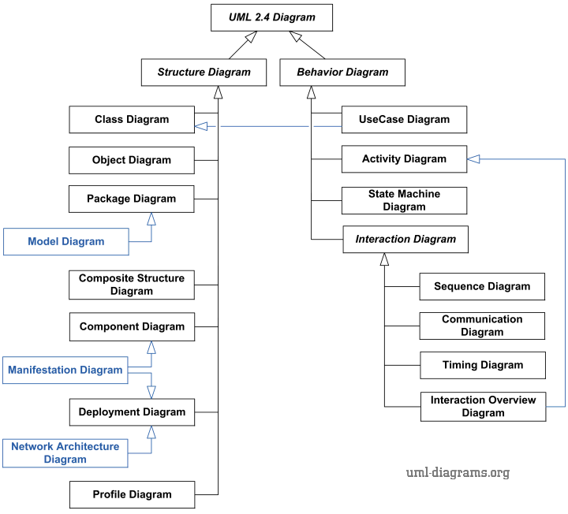
UML diagrams

Slide 101
Class diagram
A class diagram depicts classes and their interrelationships
Used for describing the internal structure of a software system
Provide a conceptual model of the system in terms of entities and their relationships
Detailed class diagrams are used for developers

Slide 102
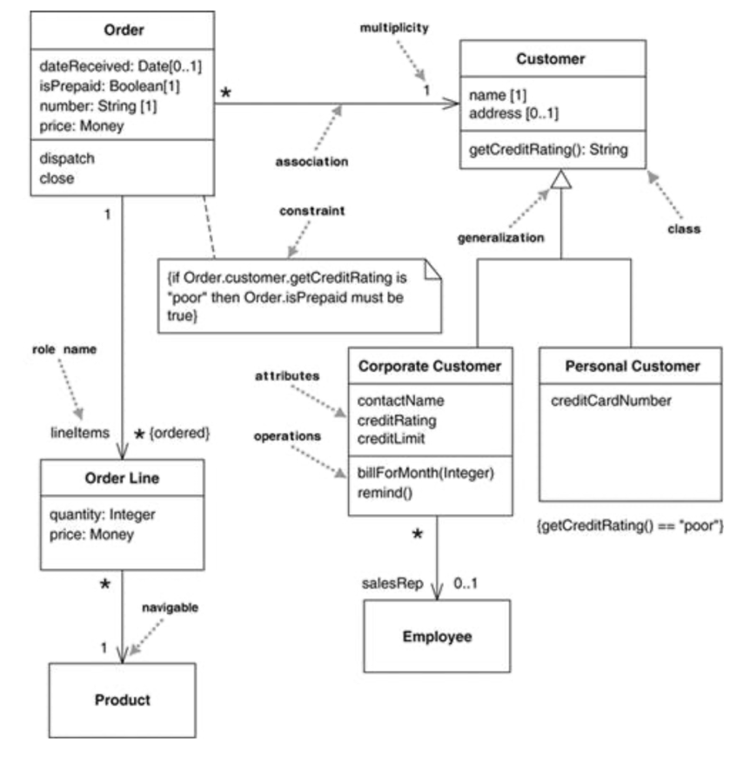
Class diagram

Slide 103
Wisdom Pills
Complexity has nothing to do with intelligence, simplicity does.
— Larry Bossidy
Perfection is achieved, not when there is nothing more to add, but when there is nothing left to take away.
— Antoine de Saint Exupery

